Slide 1
Deep Reinforcement Learning: An Overview
Paper by Yuxi Li
Presented by Aashay Chaudhari and Ben Middleton

Slide 2
Agenda
01
02
03
Core Elements of Deep Reinforcement Learning
Techniques
Applications of Deep Reinforcement Learning

Slide 3
01
Core Elements of Deep Reinforcement Learning

Slide 4
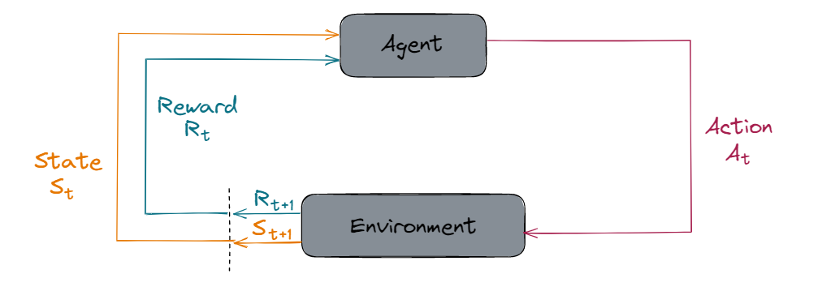
Basic Idea
-> At its core, an RL agent interacts with its environment to maximize reward
-> It endlessly performs a cycle of observing and evaluating its environment before taking an action.

Slide 5
Exploration-Exploitation Tradeoff
-> RL agents learn a lot from “trial and error,” so at any given time they have likely only explored part of the possible action space
-> In many data-driven decision making processes such as RL,
-> A model opting for exploitation will take an action that it knows will cause a good reward–the best reward it knows of.
-> A model opting for exploration might take an action with an unknown reward, hoping to find even greater reward

Slide 6
Value Function
At each step, an RL agent will attempt to evaluate its environment using a value function to try and tell how well it is doing.
-> A value function V(s) takes a state s and measures potential future rewards.
-> A value function may be used to obtain the agent’s policy and select action.
-> For some problems, a value function may need to be learned
-> As an example, we can consider Deep Q-Network (DQN)

Slide 7
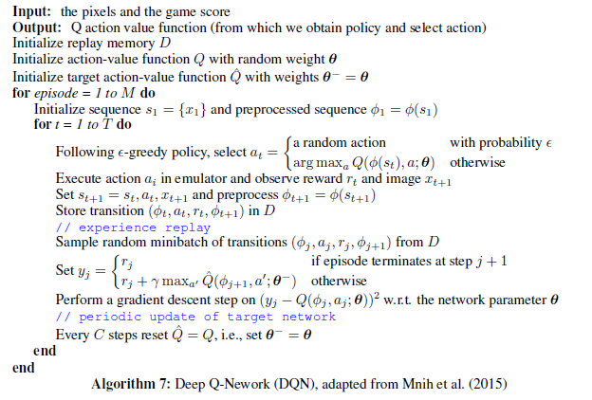
Deep Q-Network (DQN)
-> DQN is used to have a value function that is learned by the system.
-> In this game-based algorithm, DQN stores its attempts at a game
-> It will retroactively learn from them using the final reward value.
-> DQN uses “experience replay” to backpropogate reward values for t-values other than the final one.
-> Notice the chance to take a random action; this is exploration at play.

Slide 8
Policy
A policy π(s) is a mapping of each possible state s to an action the agent will take in that state.
-> There are many different methods to defining a policy, and it is closely intertwined with the value function.
-> For example, the A3C algorithm learns the value and policy functions at once.
-> Another method called policy gradient can be combined with Q-learning to cover learning the policy and reward functions while benefiting from experience replay.

Slide 9
Reward
Reward is what the agent is always trying to maximize.
-> A “good” policy will maximize rewards
-> Models are more difficult to train when rewards are given less often, but Many complex tasks cannot be evaluated until the end.
-> Take the board game “Go,” in which a reward (positive or negative) cannot be given in confidence until the game is won or lost.
-> So what happens when an RL problem has no obvious reward function?

Slide 10
Imitation Learning
-> An expert policy π_{E} is provided, and the agent must learn policy π_{θ} to match it as closely as possible
-> A discriminator D_{R} is trained to tell the difference between the two
-> After imitation learning, the discriminator can not distinguish states following π_{E} from those following π_{θ}
-> In this way, RL problems can learn from an expert without a reward function being defined.

Slide 11
Model and Planning
-> Many complex would-be RL problems can be solved more easily when the agent has an internal representation of its environment.
-> In this case, it may be able to algorithmically plan its actions ahead instead of using experience-based learning such as Q-learning.
-> When the agent is dealing with raw sensor data and has no model, planning is more difficult and so RL is used.
-> Value Iteration Networks (VIN) is a CNN planning module that can learn to plan model-free.
-> Work is still being done to integrate learning and planning into one end-to-end model.

Slide 12
Expert Knowledge
-> It is still wide open how to incorporate expert knowledge into RL
-> Experts may be able to write the optimal value, reward, policy, model, etc. for an RL model related to their expertise.
-> RL can accomplish amazing performance on certain tasks with no domain knowledge, but knowledge may be necessary for some tasks.

Slide 13
02
Techniques

Slide 14
Markov Decision Process
You might come across the term SARSA in research papers which stands for State_{t}, Action_{t}, Reward_{t}, State_{t+1} and Action_{t+1}.

Slide 15
Temporal Difference Learning
Temporal difference (TD) learning is an approach to learning how to predict a quantity that depends on future values of a given signal and using the differences in predictions over successive time steps to drive the learning process.
One of the most widely used implementation of TD is Q-learning. I will be explaining TDL with the help of Q-learning.

Slide 16
Reward Problem and Solution
The expected return of reward for episodic tasks for a time step t is given by the equation below.
G_{t} = R_{t+1} + R_{t+2}+ R_{t+3}+.....R_{T}
Where,
G_{t} = expected return at time t
R_{T} = final timestep
This becomes problematic when we have continuous tasks as the final timestep may never occur (T = ∞).

Slide 17
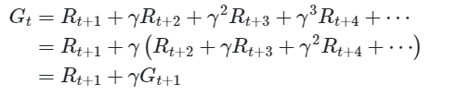
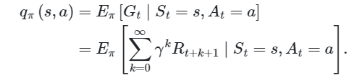
Reward Problem and Solution
For this purpose, we introduce a discount rate(γ ). The equation from previous slide then becomes:
This expected reward is then stored as the “q” (which stands for quality) value in the q table which stores all the states, actions and their corresponding q values (expected rewards, as shown in figure below).

Slide 18
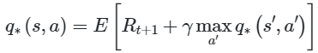
Bellman Optimality Equation
The equation below is known as bellman optimality equation.
According to this equation, the highest q-value a state-action pair can store is the expected return of reward for taking action in state s to get to the next state s’ plus the maximum expected discounted return that can be achieved from any possible next state-action pair (s’, a’).

Slide 19
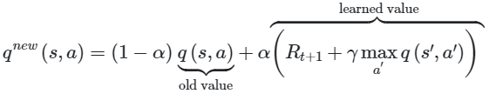
Q-Learning as Temporal Difference Learning
Update rule:
Where,
q^{new}(s,a) -> Updated value of the state
α -> Learning rate parameter
q(s’,a’) -> Maximum expected value from the next state
γ -> Discount rate

Slide 20
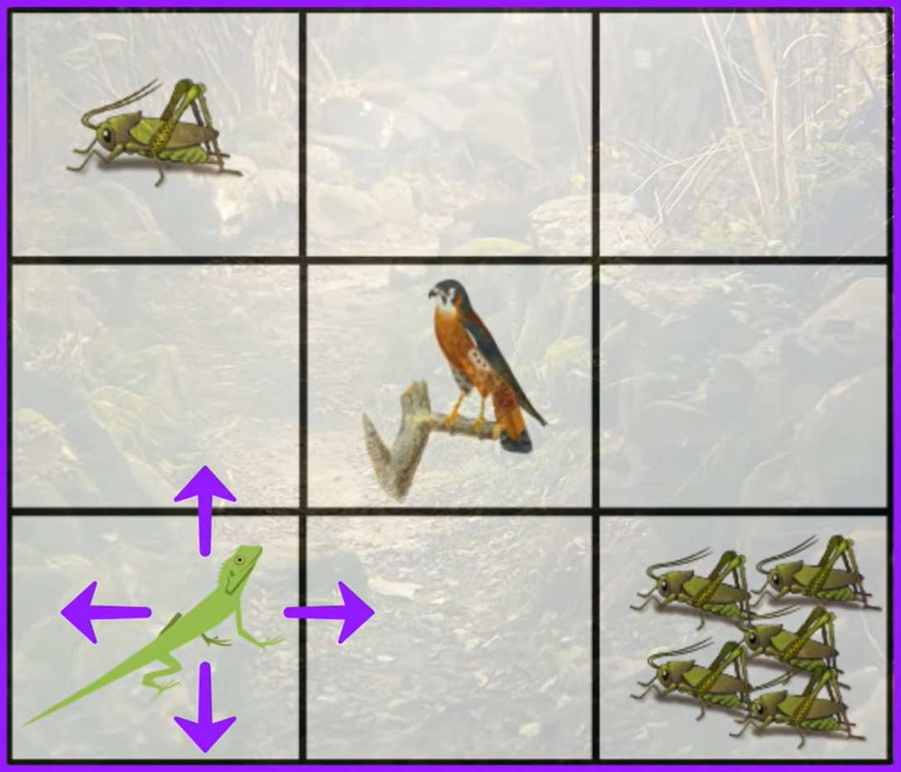

Slide 21
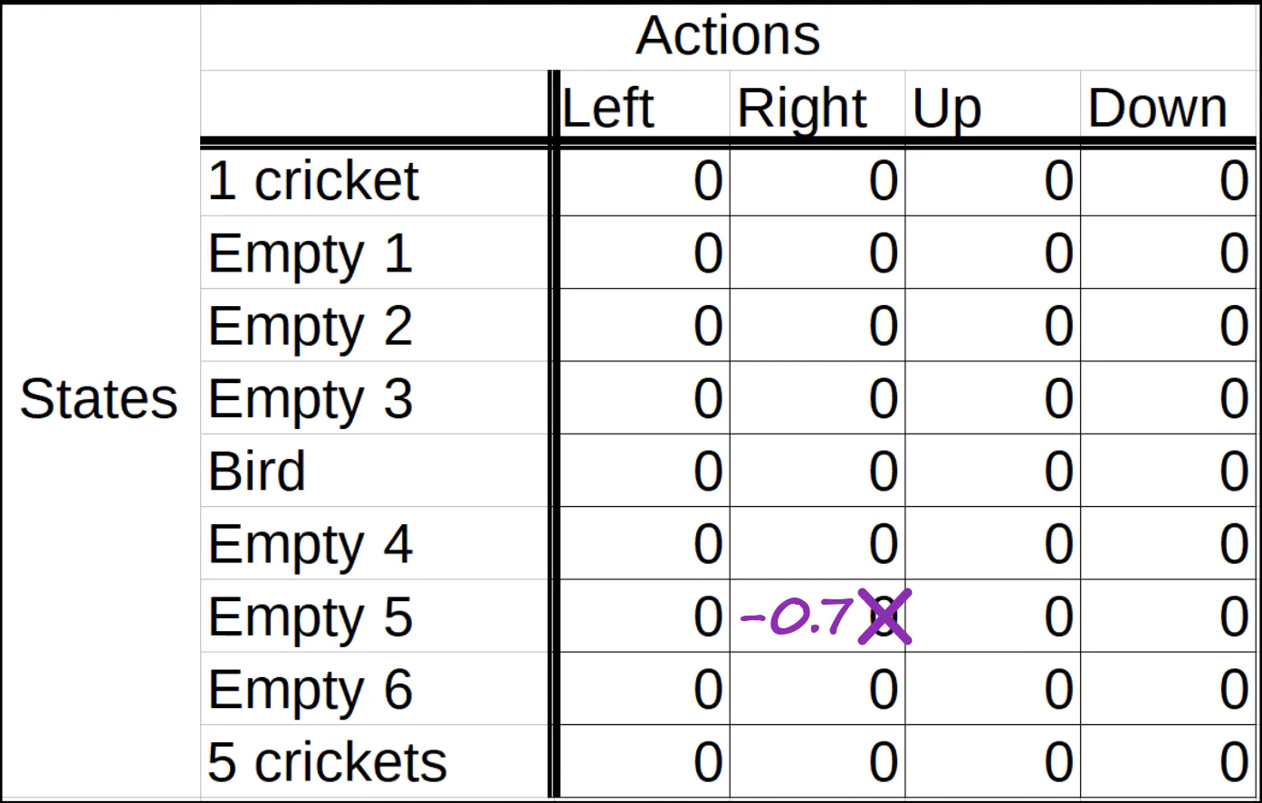

Slide 22
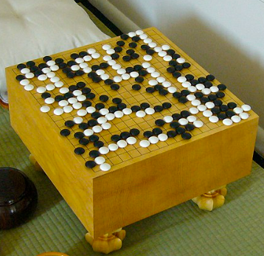
Value Function Approximation
So far, we have talked about a way which uses tables to store the states, actions and their corresponding q-values/rewards. However, this has certain limitations.
For instance, when the agent which needs to learn how to play the chinese game Go. There are over 10¹⁷⁰ different states in this game. Storing so many different states in tabular representation is inefficient.

Slide 23
Value Function Approximation
In this type of learning, we estimate the values corresponding to a particular state-action pair by using function approximation by the equation given below.
q’ (s ,a, w) = q(s ,a)
w -> The parameter which is updated using learning methods.

Slide 24
Common Function Approximators
-> Linear function approximators
-> Neural Networks
Both of these are differentiable function approximators and follow Stochastic Gradient Descent(SGD) to reach optimal states.

Slide 25
Benefits of Value Function Approximations
-> Reduces memory used to store functions (transitions, rewards, value, etc)
-> Reduces computation time to look up values
-> Reduces experience needed to find the optimal values (generalisation)

Slide 26
03
Applications of Deep Reinforcement Learning

Slide 27
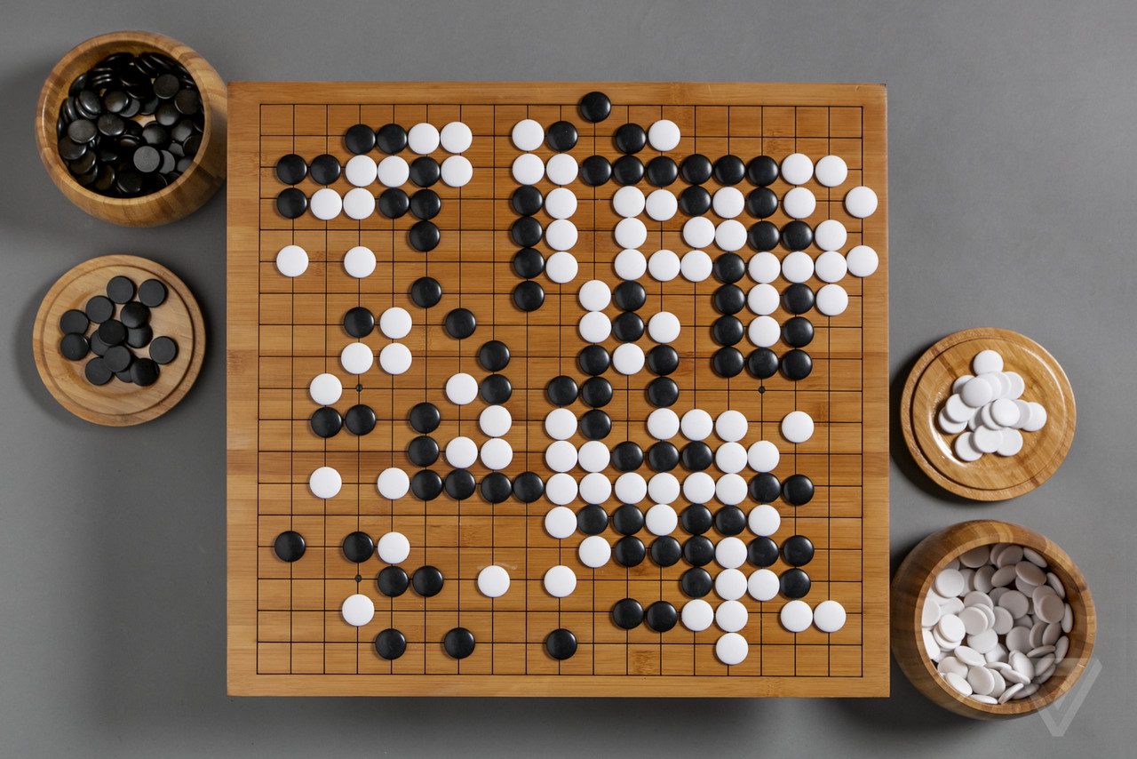
Games
-> Deep RL excels as a method for building agents for many kinds of board and video games
-> Famously, ML was used to defeat human world champions of the games Chess and Go, which are perfect information board games.
-> AlphaGo is a Go agent built in 2016 using:
-> deep convolutional neural networks
-> supervised learning
-> reinforcement learning
-> Monte Carlo Tree Search (MCTS)

Slide 28

Games
-> Imperfect information board/video games are more complex, but many agents have been successfully made for these as well
-> Texas Hold ‘em poker agents can defeat professional human players
-> Game theory for imperfect information games also has many real-world applications such as security and medical decision support.
-> Dozens of Atari games can be superhumanly beat using the same Deep RL scheme.
-> Other more modern games have been studied, and require significant work to build a single strong agent.

Slide 29
Robotics
-> Guided policy search (GPS) is “the first method that can train deep visuomotor policies for complex, high-dimensional manipulation skills with direct torque control”.
-> GPS combines RL with supervised learning to solve many long-term training issues that supervised learning alone might have.
-> In navigation, complex 3D mazes can be solved by agents at a human level.
-> Navigation is a “by-product” of the agent’s goal, finding the exit.

Slide 30
Natural Language Processing
-> With previous generations of chatbots, shallow learning did exist, but only part of the task hoping to be accomplished was really handled by the “AI” part of the system.
-> With deep learning, the learning is end-to-end (E2E).
-> The entire system, input to output, is learned, including every system parameter.
-> An E2E system might be given only spoken audio as input, and output an answer to a complex question
-> A recent example would be ChatGPT, launched November 30, 2022.
-> Like many RL models, it used supervised learning combined with RL.

Slide 31
Computer Vision
-> Computer vision problems deal with computers gaining understanding of images or videos.
-> Shape recognition
-> Face recognition
-> Motion analysis (understanding moving objects in a series of pictures)
-> Understanding can be useful in deriving policy for games and self-driving vehicles.
-> This can be combined with NLP for better semantic understanding

Slide 32
Others
-> Predicting financial markets (i.e. stock prices)
-> Hard to reconcile human biases in prices, but still a strong prediction tool
-> It’s difficult to convince people to trust their money to a “black box” method regardless of its performance.
-> Recommendations, with “clicks” used as the reward:
-> Serving personalized ads
-> Recommending shows, videos, articles, etc.
-> In healthcare, dynamic treatment regimes (DTRs) can be developed for patients with chronic illness based on their medical history using Q-learning.
-> RL may become deeply applicable to many more areas, such as manufacturing, intelligent transport systems, power grids, or even education.

Slide 33
Thanks!

